Slide 1
Crack Pipe
(Burnin’ My Hand)
IST 718 – Big Data Analysis
Kathy Adams, Danielle Castelli, John Green, Peter Mathews

Slide 2
Objective
To better understand the opioid epidemic in New York and to provide a tool to assist health and law enforcement officials in managing the crisis as this is an ongoing, urgent problem throughout our society

Slide 3
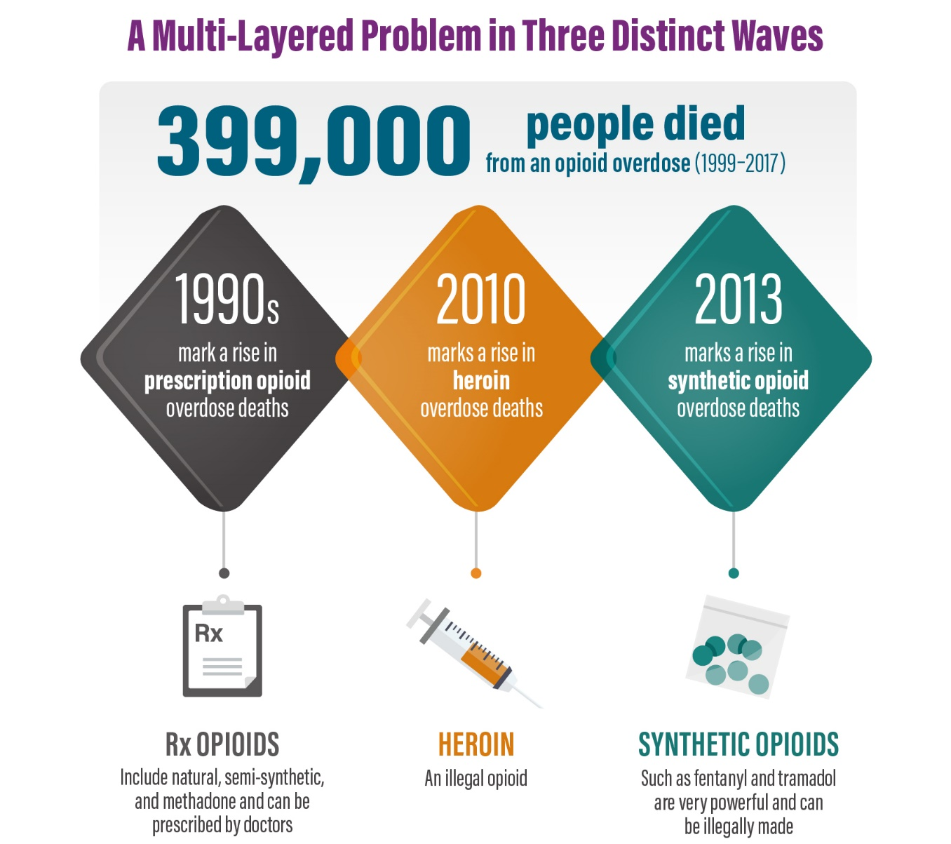
Rise in US Opioid Deaths
Source: https://www.cdc.gov/drugoverdose/data/analysis.html
Notes:
From 1999 to 2017, almost 218,000 people died in the United States from overdoses related to prescription opioids. Overdose deaths involving prescription opioids were five times higher in 2017 than in 1999.¹

Slide 4
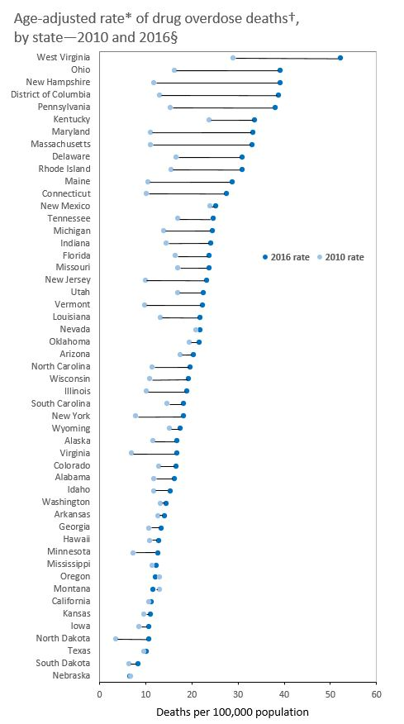
CDC Death Rate Increases
Notes:
*Rates shown are the number of deaths per 100,000 population. Age-adjusted death rates were calculated by applying age-specific death rates to the 2000 U.S. standard population age distribution.
† Deaths are classified using the International Classification of Diseases, Tenth Revision (ICD–10). Panel includes drug overdose deaths identified using underlying cause-of-death codes X40–X44, X60–X64, X85, and Y10–Y14.
Source: https://www.cdc.gov/drugoverdose/data/statedeaths/drug-overdose-death-rate-increase-2013-2017.html

Slide 5
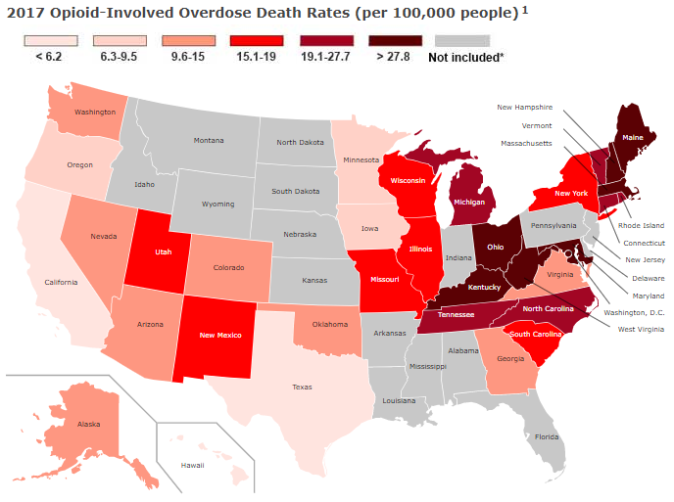
Just How Bad Is It Now?
Source: https://www.drugabuse.gov/drugs-abuse/opioids/opioid-summaries-by-state
Notes:
NY: Opioid-Involved Overdose Deaths/100k persons (2017) = 16.1 and Opioid Prescriptions/100 persons (2017) = 37.8

Slide 6
Goal
Develop prototype tool to:
Analyze the quantity of opioids (measured in Morphine Milligram Equivalents or MMEs) distributed to pharmacies over time
Forecast future distributions
Predict potential hot spots of opioid misuse

Slide 7
Obtain
Dataset was obtained from the Drug Enforcement Administration’s Automated Reports and Consolidated Ordering System (DEA ARCOS)
Initial dataset contained over 550M records for all states from 2006 - 2014
This tool focuses on New York State
Notes:
DEA ARCOS: a data collection system in which manufacturers and distributors report their controlled substances transactions

Slide 8

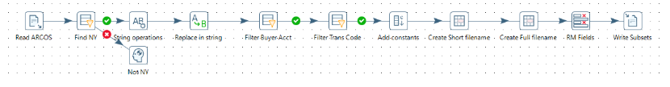
Scrub
Pentaho used to reduce initial dataset:
NY state only
Sale transactions
Chain and retail pharmacy buyers only
Grouped in files by drug name
Notes:
Now that we had obtained the data, utilized Data Engineering expertise to wrangle the 100 GB file.
Utilizing Pentaho and a 1TB hard drive, that allowed us to decompress the data and then extract/filter/init clean the NY state specific transactions.
The ETL process generated multiple files organizing the transaction by drug name.
Execution time: 3.5 hour to complete (~40K r/s) . Only performed ~3 times.

Slide 9


Scrub
Python and Spark used to:
Clean up drug names
Format dates
Normalize monthly data by day counts
Remove unneeded columns
Merged data and compute MME/Day
Dropped all 2006 transaction.
Deliver clean data set in Parque and CSV
Notes:
Used Fentinal, very low transaction count, to build out the scrub and EDA process prior to wrangling Oxy and Hydro.
Now we had the data extracted in a manageable way. Based on the size of Hydro and Oxy files, it was evident the most popular.
OXY = 2.5 GB | Hydro = 2.1 GB
Normalized dates to year month and tacked on the last day of the week.
After extraction, data formatted as parquet and csv files to support exploration, analysis and prediction, and visualization
This reduced the need for repeating scrub process everytime we modified our EDA, Forecasting, and Visualizations.

Slide 10
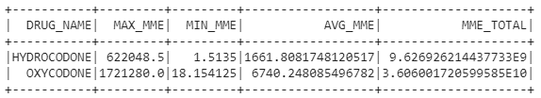
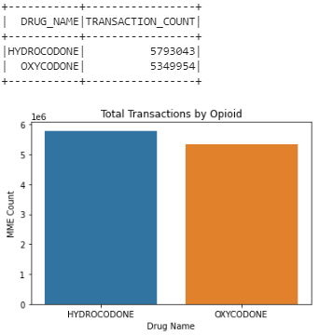
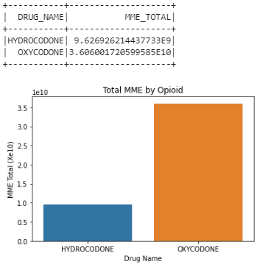
Oxycodone vs Hydrocodone
Transactions
Drug Quantities
Notes:
The first important observation made by the team was how much MME was being shipped for both Hydrocodone and Oxycodone.
Hydro has the the most transactions though Oxy transactions have the highest mme:transaction ratio.
Notice the average MME per transaction is about 6.7K vs. Hydro’s 1.66K average mme per transaction. This is expected based on potency of Oxy.
MME measures potency.

Slide 11
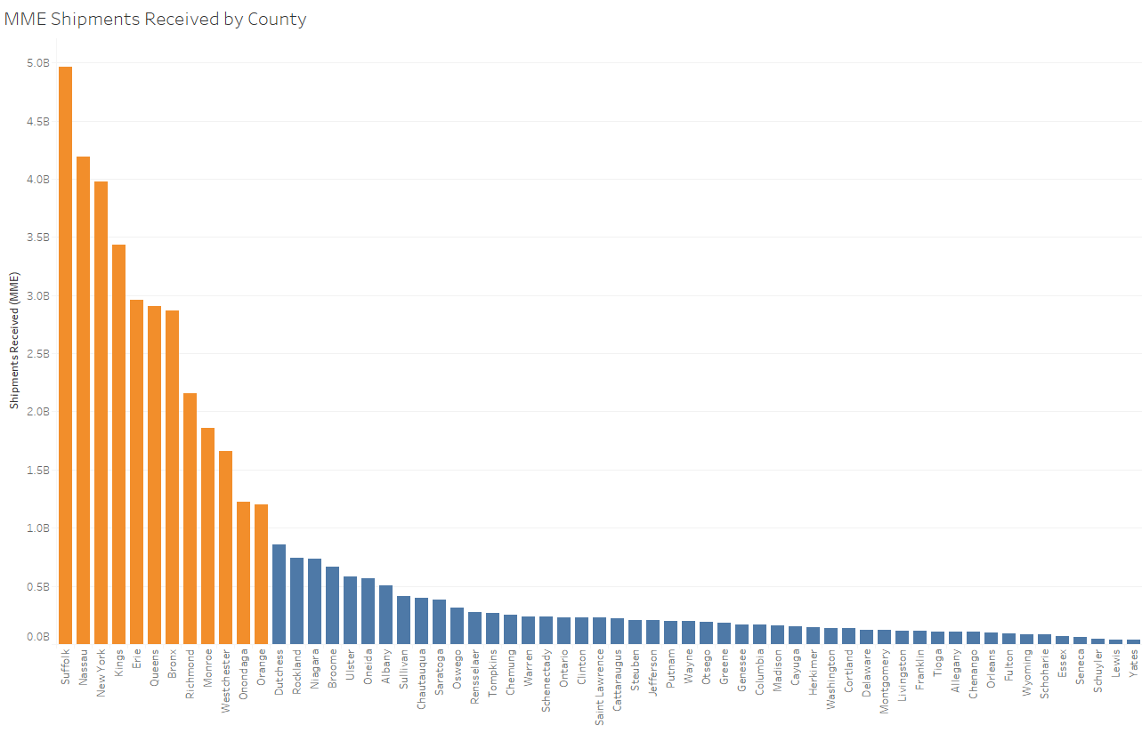
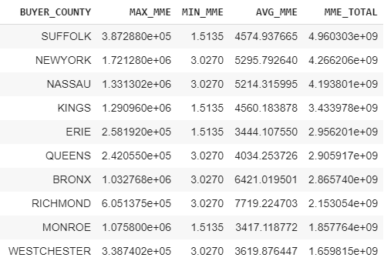
Explore by County
12 counties received over 1 billion MME in opioids from 2007-2014
Notes:
Confirming that high population counties are the ones with the highest shipments of drugs. No real red flags based on this data alone.

Slide 12
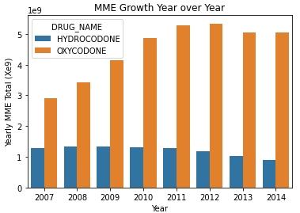
Yearly Growth by Drug
Notes:
MME Growth Y-o-Y
To understand the opioid problem in New York, a bar plot provided insight into the year-over-year growth rates of both Hydrocodone and Oxycodone.
This supports the allegations that pharmaceutical companies are pushing Oxycodone.

Slide 13
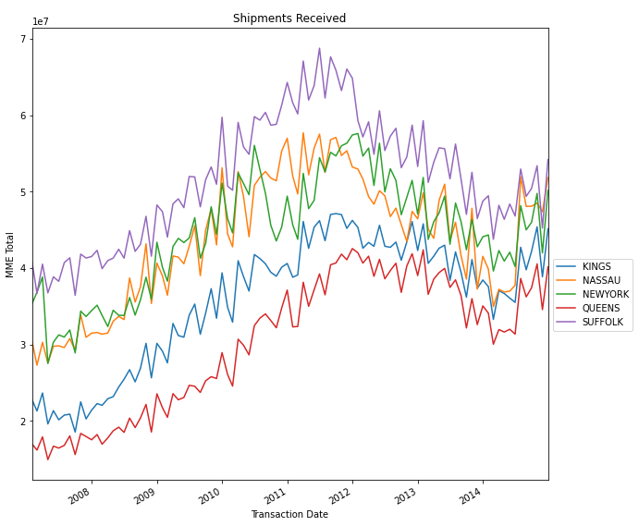
Monthly Shipments by County
Top 5 counties show continued growth in total shipments
Notes:
Before we moved forward with forecasting, it was important to us to verify the MME growth trend m-o-m. Confirms the uptrend growth.
Noticed a spike in 2014 to the upside.
Any inclination of growth again.

Slide 14

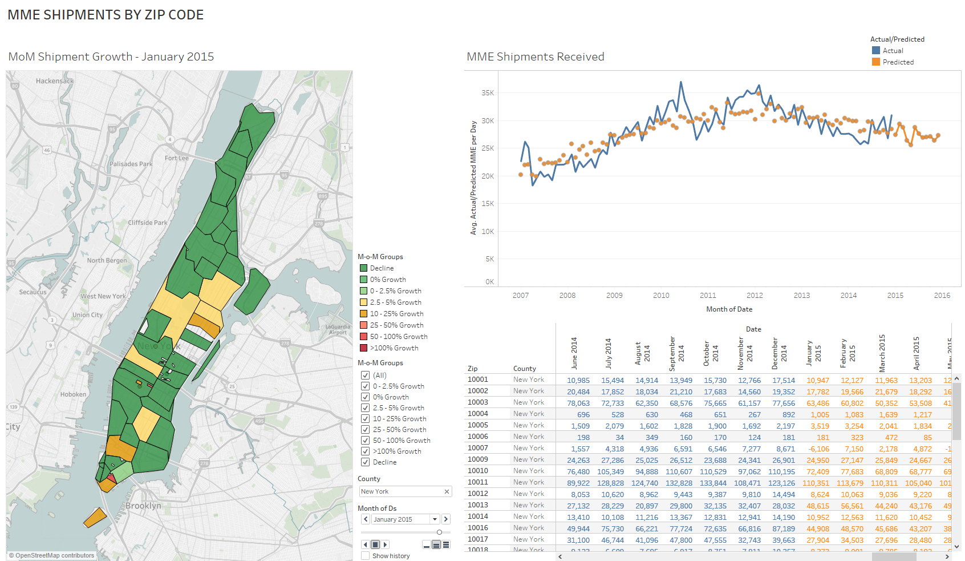
Prediction: January 2015
Notes:
Demo Tableau

Slide 15
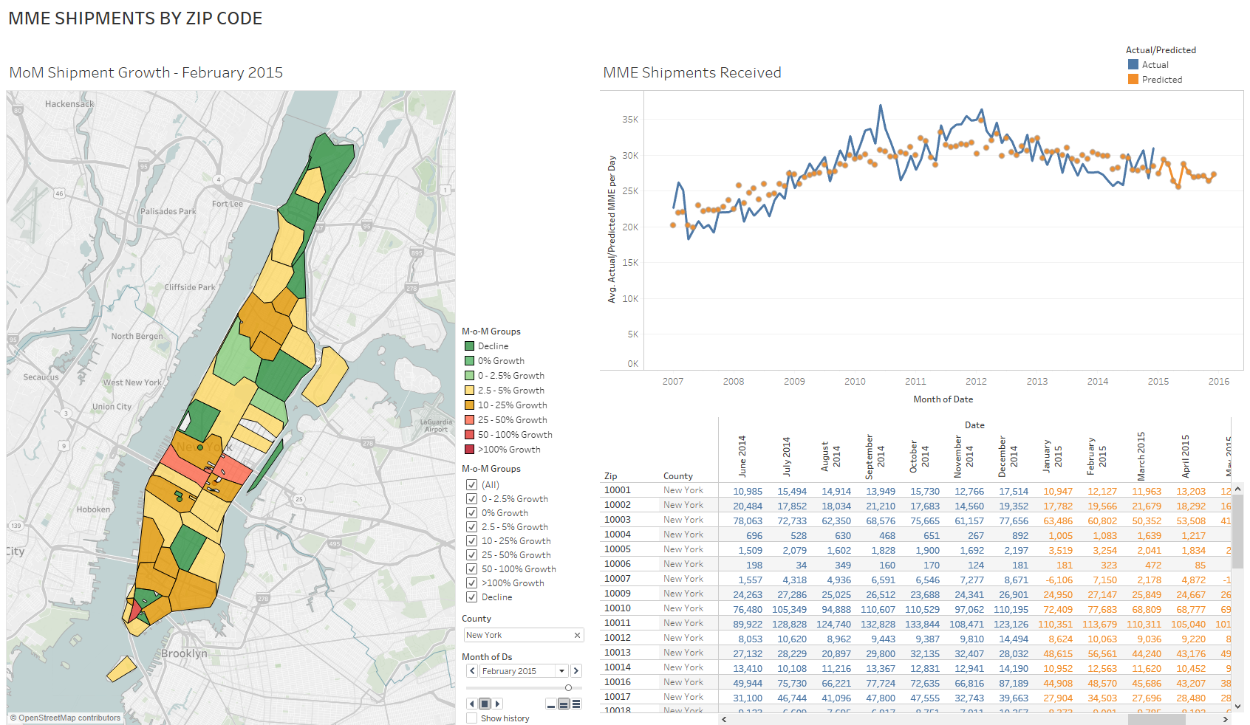
Prediction: February 2015
Notes:
Demo Tableau

Slide 16
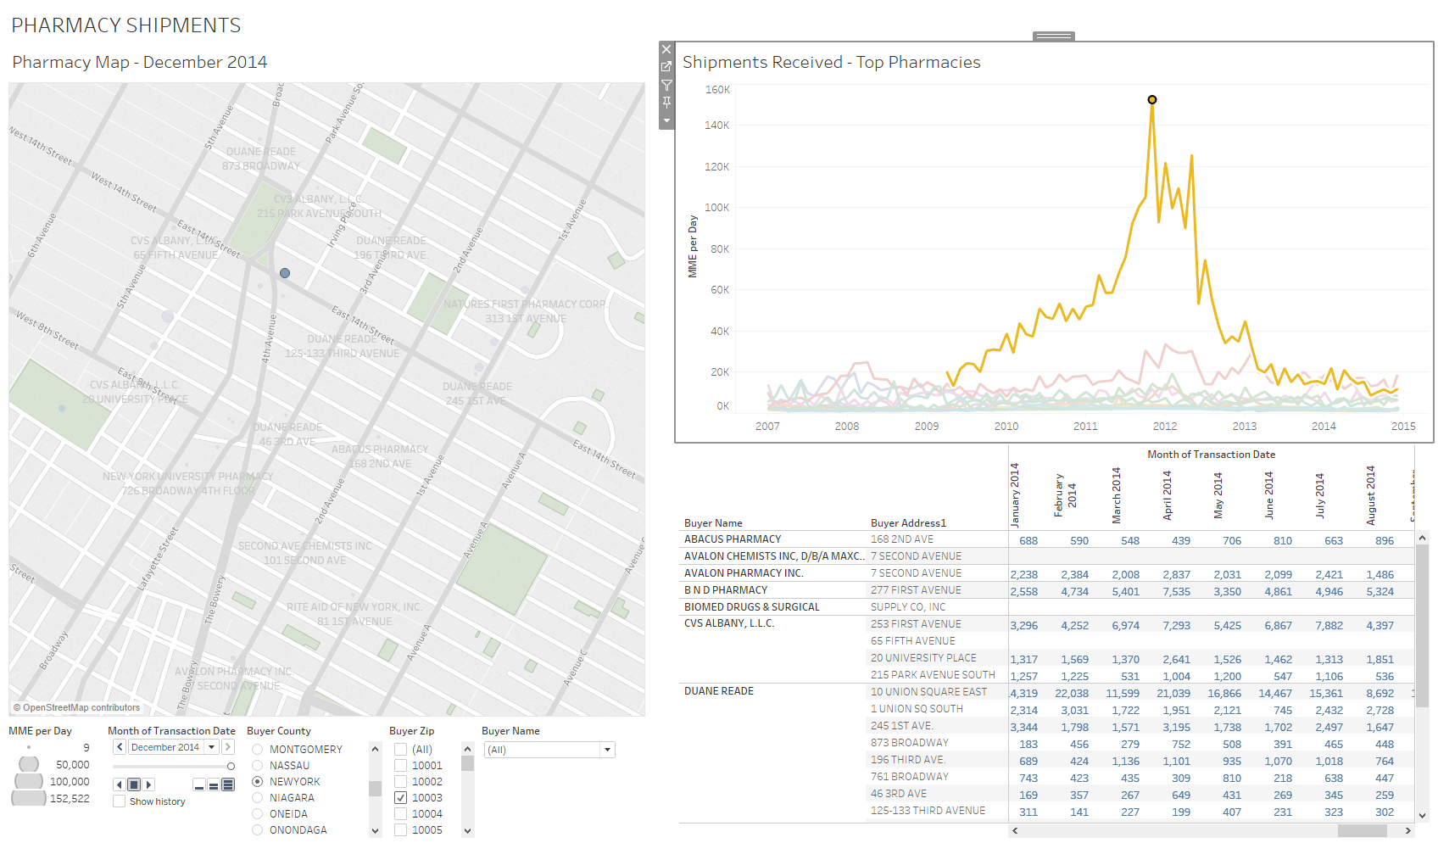
Closer Look by Zip Code

Slide 17
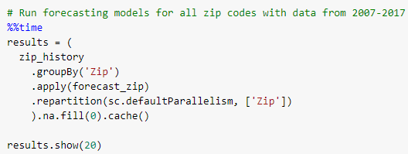
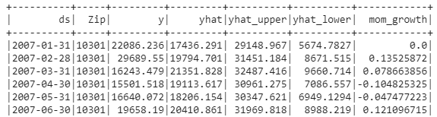
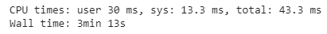
BDA with Spark

Slide 18
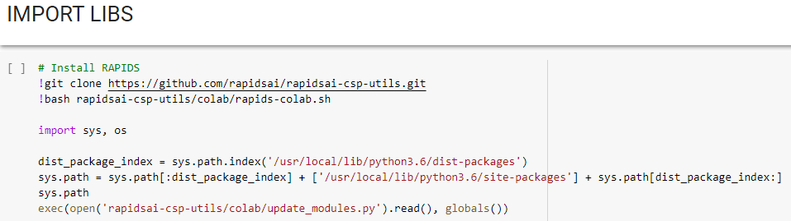

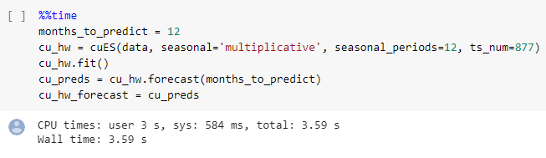
BDA with RAPIDS
Notes:
GPU processing for model prediction

Slide 19

Conclusions
Scalable prototype for monitoring and forecasting is achievable
powerful and quick for in-depth analysis of large-scale data set
can be adapted for other states or jurisdictions
user-friendly interface for easy identification of potential problem areas

Slide 20
References
DEA ARCOS data retrieved from: https://www.slcg.com/
CDC Injury Center website:
https://www.cdc.gov/drugoverdose/data/analysis.html
https://www.cdc.gov/drugoverdose/data/statedeaths/drug-overdose-death-rate-increase-2013-2017.html
National Institute on Drug Abuse (NIDA):
https://www.drugabuse.gov/drugs-abuse/opioids/opioid-summaries-by-state

